Slide 1
California Housing
California Housing Dataset : Regression Problem, predictions made for the “median_house_price” using the distance and tree based models.

Slide 2
FE&EDA : Approach
So, for this dataset, there was only one categorical column, and in it, I used the label encoding because of the nature of the feature, apart from that, I applied some calculations for other feature (which can be found in the cleaned file), then afterwards, I applied the scaler to make the copy of the cleaned dataset for the Distance based models, kept the original copy for the tree based models, with minimalistic FE&EDA.
In this file, I used the scaled data for the Distance based models and plain cleaned data for the tree based models.

Slide 3
Distance based models

Slide 4


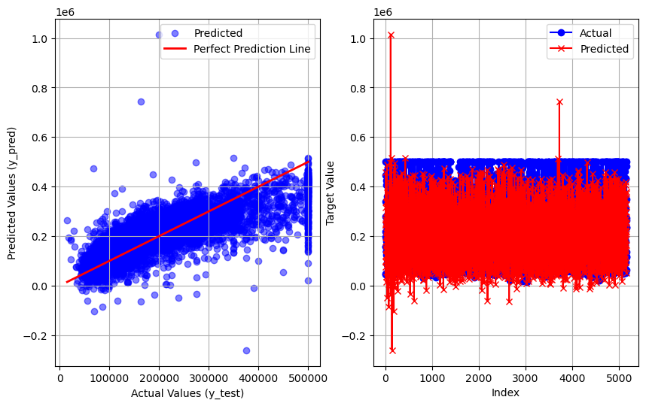

Linear Regression
r2 score : 0.5761006935510993
MAE : 53825.90785106171
RMSE : 74894.00756758172
MSE : 5609112369.532989

Slide 5
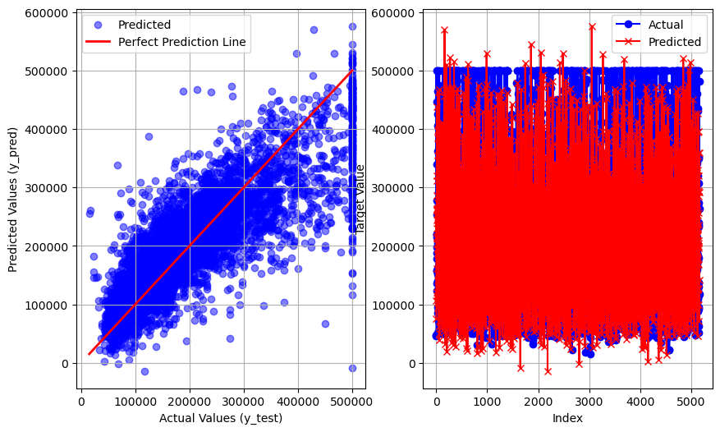
SVR
r2 score : 0.66533703215511
MAE : 47680.25056685246
RMSE : 66545.63081798195
MSE : 4428320980.963148

Slide 6
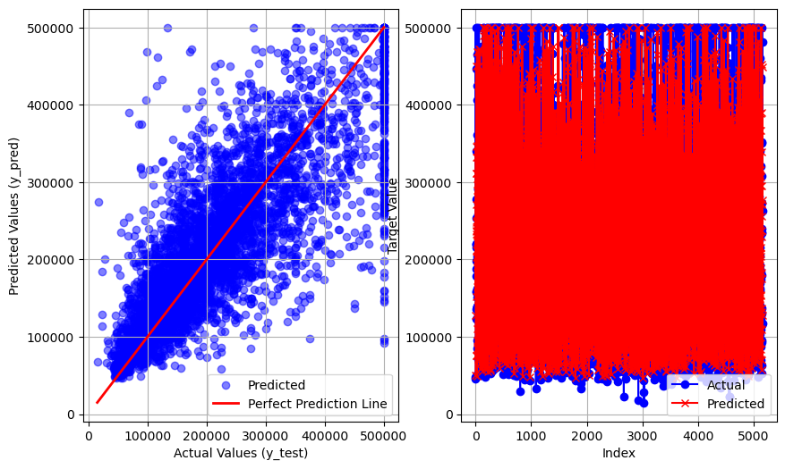
KNN
r2 score : 0.65222913310871
MAE : 45627.97802325582
RMSE : 67836.3256251313
MSE : 4601767074.318846

Slide 7

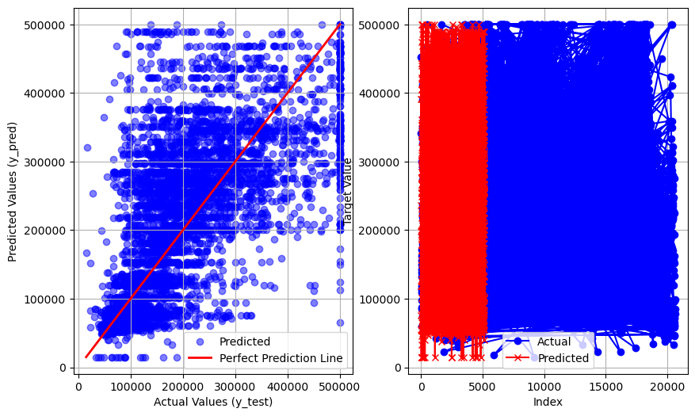
Probability based model : Gausian NB
r2 score : 0.2588227201936192
MAE : 71448.26492248062
RMSE : 99032.27734380636
MSE : 9807391955.900581

Slide 8
Probability based model : Gausian NB
r2 score : 0.2588227201936192
MAE : 71448.26492248062
RMSE : 99032.27734380636
MSE : 9807391955.900581

Slide 9
Tree based models

Slide 10
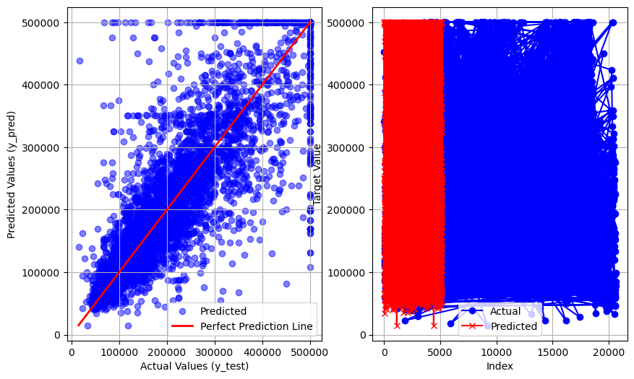
Decision Tree
r2 score : 0.6770221172669804
MAE : 40643.49069767442
RMSE : 65373.55596254783
MSE : 4273701819.188372

Slide 11
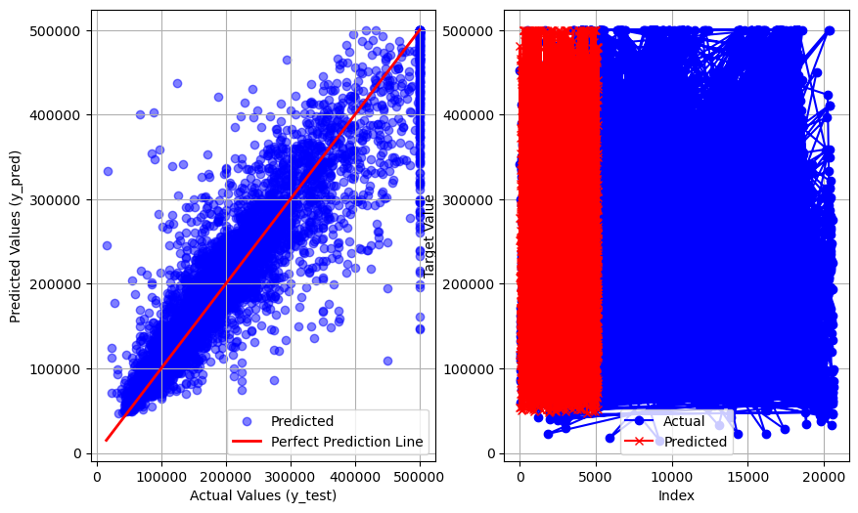
Random Forest
r2 score : 0.8168065578343209
MAE : 31327.422916666666
RMSE : 49234.6300255197
MSE : 2424048793.749806

Slide 12
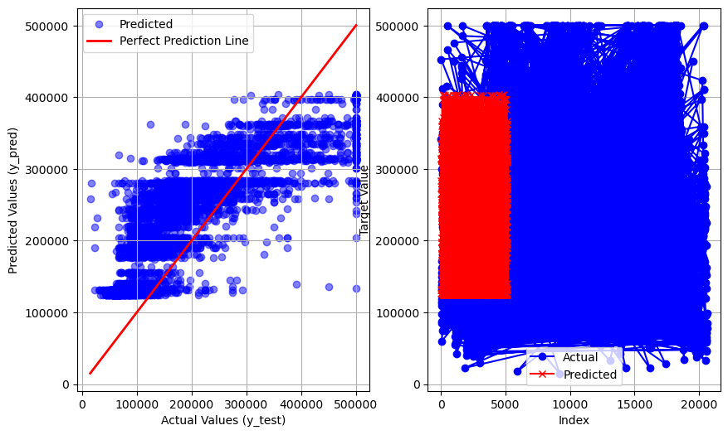
Adaboost
r2 score : 0.4996903246017502
MAE : 69085.60759962526
RMSE : 81364.53899274356
MSE : 6620188205.501687

Slide 13
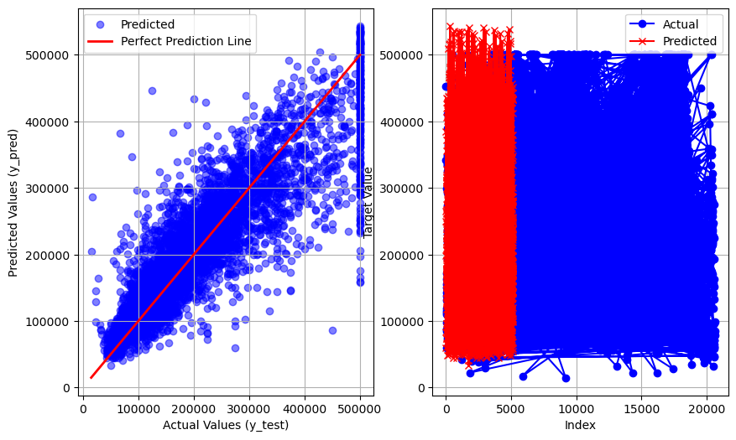
Gradientboost
r2 score : 0.7710954073496845
MAE : 37856.67991853368
RMSE : 55035.506838100395
MSE : 3028907012.926595

Slide 14
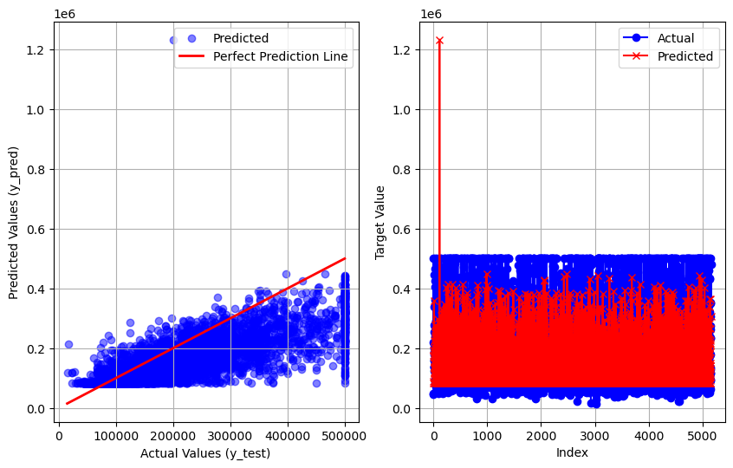
DL : ANN
r2 score : 0.3888625390443404
MAE : 63791.55605922965
RMSE : 89925.97805568544
MSE : 8086681529.271618

Slide 15
Thanks for watching.
Made by : Utsav,
Github : utsav87589

